Slide 1
Introduction to PowerShell

Slide 2
Contents
Aim
Background
.NET
Primitive Data Types
Comparison Operators
Variables
Control Structures
Functions
Common APIs
Coding Standard
Further Reading

Slide 3
Aim
What will you learn?
What will you get out of it?
What will you be able to do after the course?

Slide 4
Background
Scripting Language
Based on .Net framework
Object-Based as opposed to text based
ISE
Naming Structure

Slide 5
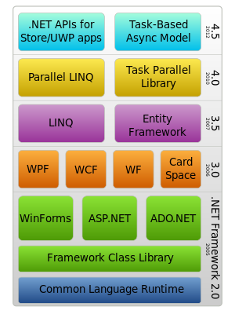
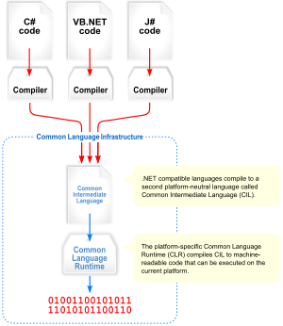
.NET

Slide 6
Primitive Data Types
Boolean
String
Int
Notes:
Example

Slide 7
Comparison Operators
Gt
Lt
Like
Eq

Slide 8
Variables
What is a variable (placeholder to store variable)

Slide 9
Control Structures
If
While
Foreach

Slide 10
Functions
What is a function
Syntax
Why use functions
Functions with parameters

Slide 11
Common APIs
Office 365 (Exchage)
Office 365 (Msol)
On-Premise Exchange
Cloud Exchange
Active Directory
Remote Desktop Manager
Vmware
Google
Etc etc

Slide 12
Coding Standard
Bad
Good

Slide 13
Further Reading
What can I do?: https://technet.microsoft.com/en-gb/library/ee332526.aspx
.Net: http://www.codeproject.com/Articles/3992/What-is-NET
Use Powershell in Unity: https://balladelli.com/psunity/
Automating tasks using workflows: https://www.simple-talk.com/sysadmin/powershell/automating-day-to-day-powershell-admin-tasks-jobs-and-workflow/
Object-Orientated Programming: http://searchsoa.techtarget.com/definition/object-oriented-programming
ISE Tips: https://4sysops.com/archives/10-reasons-for-using-powershell-ise-instead-of-the-powershell-console/
Primitive Data Types: https://technet.microsoft.com/en-us/magazine/ff642464.aspx
Comparison Operators: https://technet.microsoft.com/en-gb/library/hh847759.aspx
Variables: https://technet.microsoft.com/en-us/library/hh849913.aspx
Control Structures: https://en.wikiversity.org/wiki/Windows_PowerShell/Loops
Functions: http://windowsitpro.com/windows/create-your-own-powershell-functions
Office 365 (Exchange): https://technet.microsoft.com/en-us/library/jj984289(v=exchg.160).aspx
Office 365 (Msol): https://msdn.microsoft.com/en-us/library/azure/jj151815(v=azure.98).aspx
Coding Standards: https://blogs.technet.microsoft.com/pstips/2014/06/17/powershell-scripting-best-practices/
Coding Standards: http://windowsitpro.com/blog/my-12-powershell-best-practices

